Slide 1
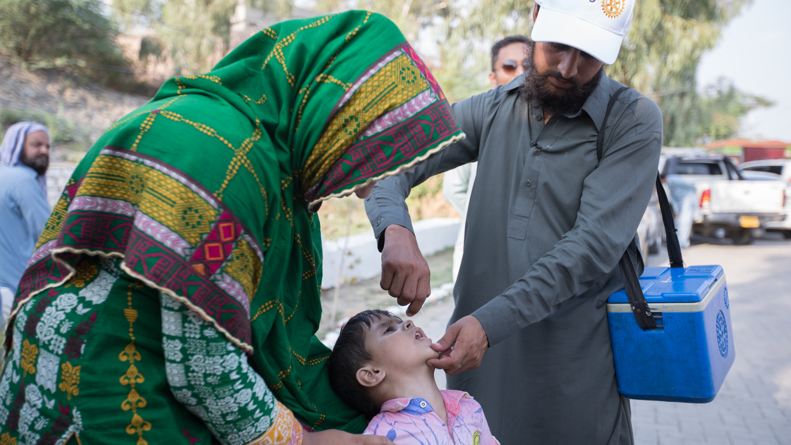
Club experience
Awareness spreading
PETS Alliance Training Summer 2023
Notes:
We wanted to come to the committee liaison training with an important research finding that you can help disseminate.

Slide 2
Overall Conclusion:
The Club Experience Matters more than Anything Else
Notes:
Over the past few years, the Research & Evaluation team surveyed members multiple times, and a consistent theme that has emerged from these surveys is that the club experience matters for members more than anything else. As the primary way Rotarians and Rotaractors experience Rotary, a positive club experience is the way to retain and recruit members.

Slide 3
2021 & 2022 Rotary
  All Member Survey
  Programs & Offerings Survey
  Leadership Survey
  2022 Awareness & Understanding Survey (conducted by Leger)
Data sources
Notes:
The data for this conclusion comes from all three Rotary annual surveys: the All-Rotarian, Programs & Offerings, and Leadership. Here you can see the number of responses collected and response rates for each survey. Typically, response rates for Rotary International’s survey is above average since the average response rate for an online survey is less than 1 percent.

Slide 4
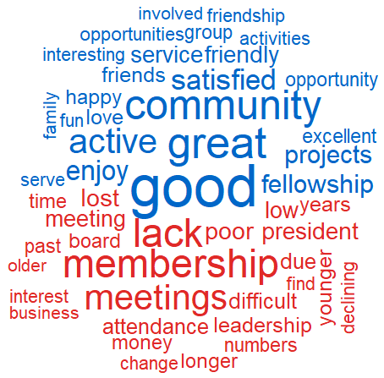
What Satisfied Members say
about their clubs:
What Dissatisfied Members say about their clubs:
Source: 2022 Rotary All-Rotarian Survey
Notes:
Satisfied members are happy with their club. They're involved in the community, friendship, they get involved in projects
Dissatisfied members think things are poor, difficult, declining,

Slide 5
Meeting Enjoyment
Confidence in Club Leadership
Satisfaction with Club Service (involvement in club activities)
Satisfaction with Finding Friends
Comfort with other club Rotarians
Most important factors for overall Rotarian satisfaction
Notes:
These variables work together to provide a positive Rotarian experience

Slide 6
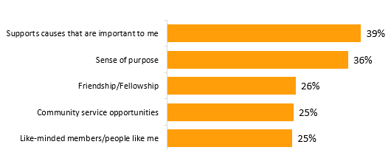

General Public Agrees
Top 5 attributes when joining a nonprofit:
Notes:
For context, you can preface that RI regularly conducts research with the general public around the globe to assess awareness, understanding and perceptions of Rotary as well as to understand features that are of most interest to potential participants. The results can inform our communication, engagement, recruitment strategies and provide insight into future programs and offerings.

Slide 7
Ask members what they want! Listen to what they say!
Get members involved in club meetings
Do more service projects​ in your community
Improve club meetings w/ better speakers, time management, and leader engagement
Improving the Club experience
Notes:
These variables work together to provide a positive Rotarian experience

Slide 8
discussion

